Slide 1
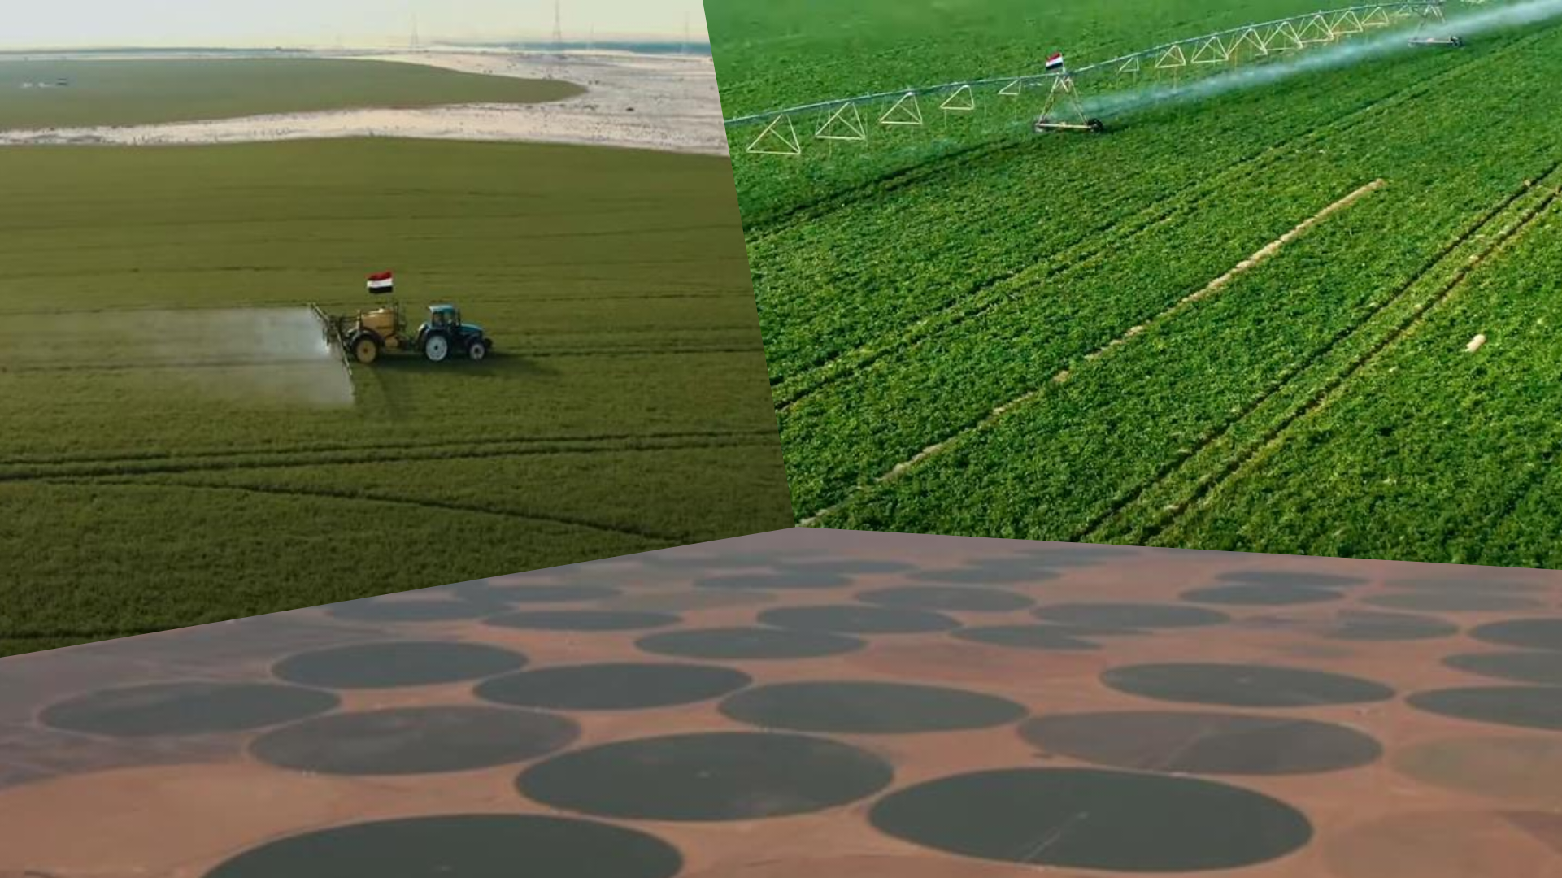

AGRICULTURE IN EGYPT
AND COMPARE IT WITH AGRICULTURE IN NIGERIA

Slide 2



This presentation includes a comparison between Egypt and Nigeria in certain agricultural aspects. But why compare Egypt with Nigeria specifically? We will find out.

Slide 3
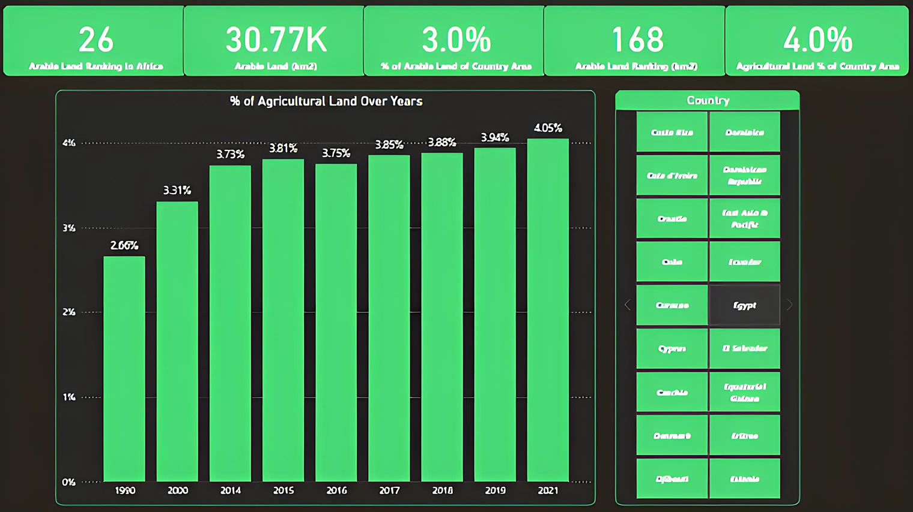
Arable land includes both Permanent and Temporary crops and represents 3% of Egypt's area, which is 30.77 thousand km². Meanwhile, agricultural land, which includes arable land and pastures, represents 4% of Egypt's area, approximately 40 thousand km². Egypt's rank in terms of arable land by km² is 168th globally and 26th in Africa. This is not surprising since Egypt is a desert country.

Slide 4
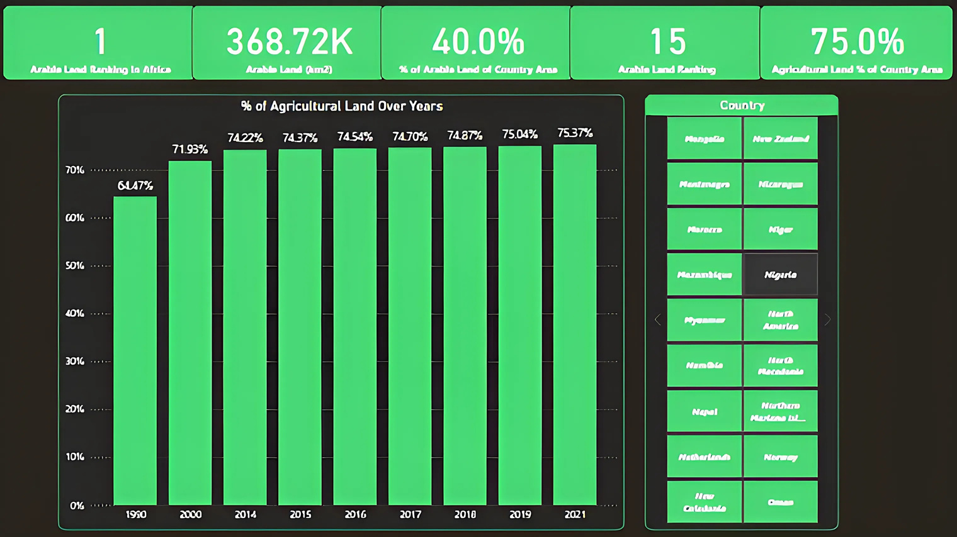
Nigeria's total area is 923,768 km², while Egypt's total area is 1,001,450 km², making them comparable in land size. This is the first reason for comparing the two countries. The second reason is that despite their similar land sizes, Nigeria has 75% agricultural land, approximately 693 thousand km², whereas Egypt has only 5.7% of the agricultural land that Nigeria has. In terms of arable land, Nigeria has 368.72 thousand km², which is 40% of its area, while Egypt has only 8.1% of the arable land that Nigeria has. When considering the numbers, with Nigeria being ranked 1st in Africa and 15th in the world in terms of arable land area, It is logical that the difference between them is large in the volume of production. However, let us look at some other numbers.

Slide 5
If we look at the percentage of agricultural land over the years in both countries, specifically from 2014 to 2021, we will find natural increases or decreases without sudden jumps or declines. Agricultural land in Egypt in 2021, compared to 1990, has increased by 52.3%, and compared to 2000, it has increased by 22.4%. But does Egypt employ modern farming methods to increase yield per acre? This is what the numbers in the upcoming slides will answer.

Slide 6
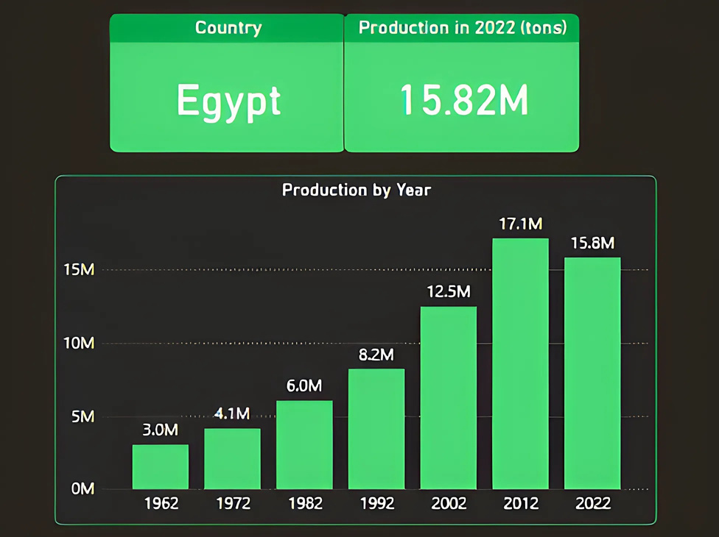
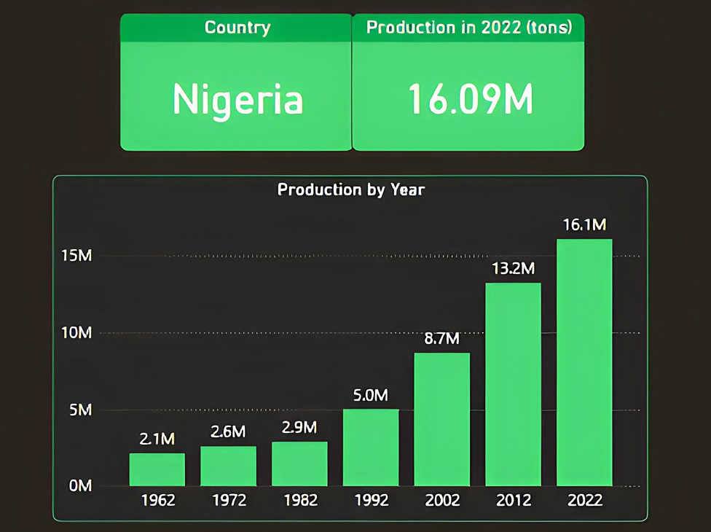
VEGETABLES PRODUCTION
In 2022, Egypt produced 15.82 million tons of vegetables, placing it eighth globally, despite having one of the smallest arable land areas among world countries. In contrast, Nigeria produced 16.09 million tons, placing it seventh globally, despite Nigeria's significantly larger arable land area compared to Egypt. This has been previously discussed. Egypt's vegetable production was 17.1 million tons, but in 2022 it was 15.8 million tons, despite a significant increase in production from 1962 to 2012.

Slide 7
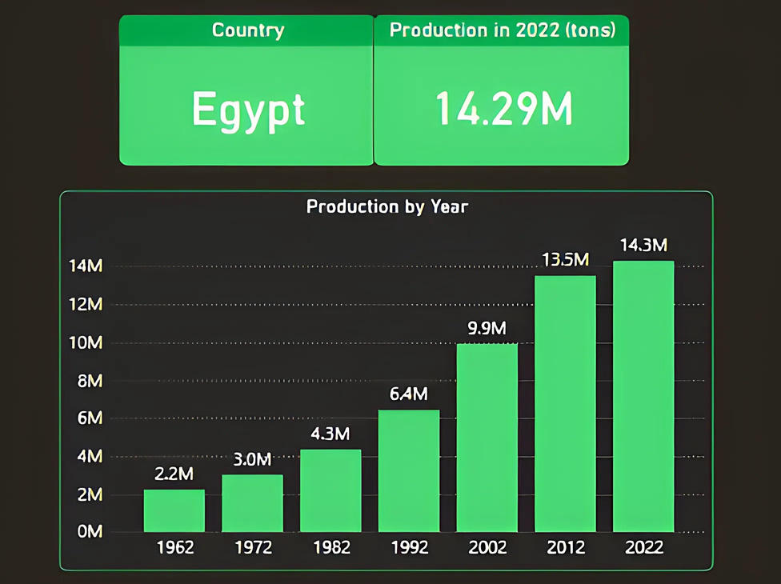
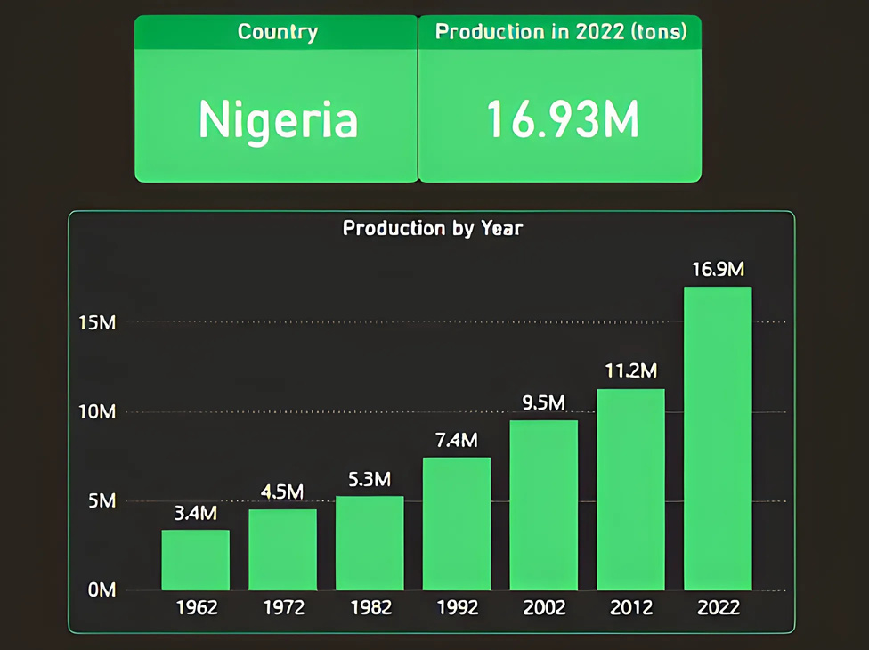
FRUIT PRODUCTION
Egypt's fruit production was 14.29 million tons in 2022, ranking it 14th globally, while Nigeria produced 16.93 million tons, placing Nigeria 10th globally. We observe that Egypt's fruit production increased steadily from 1962 to 2022, but the smallest increase was between 2012 and 2022.

Slide 8
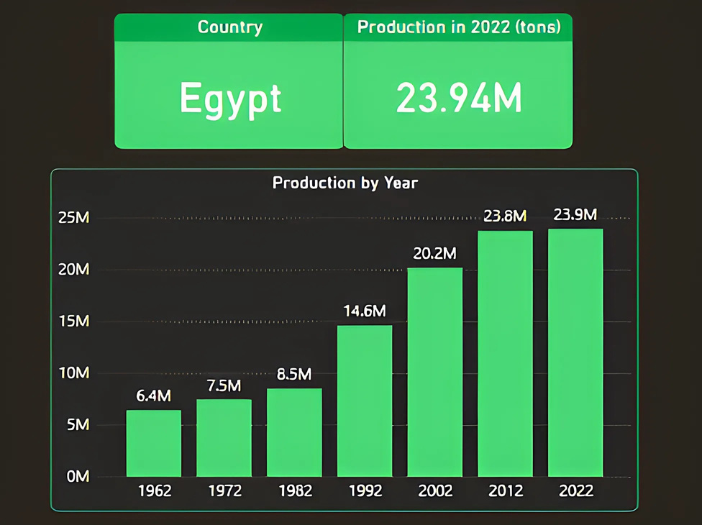
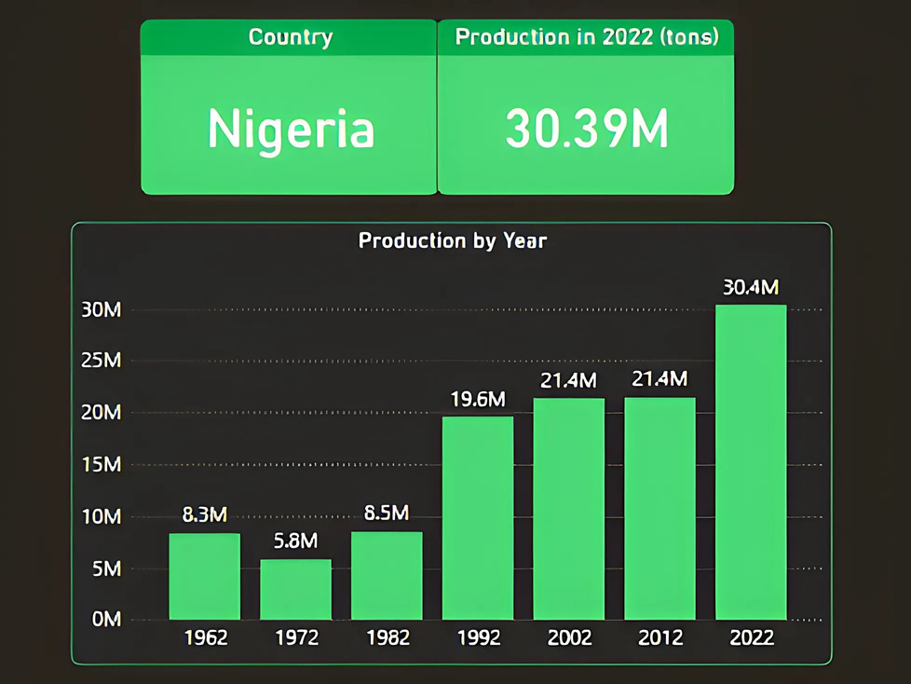
CEREALS PRODUCTION
In 2022, Egypt produced 23.94 million tons of cereals, ranking 24th globally, while Nigeria produced 30.39 million tons, placing it 22nd globally. Cereals production in Egypt had shown significant increases over the years, but between 2012 and 2022, production only increased by 100,000 tons, from 23.8 million tons in 2012 to 23.9 million tons in 2022.

Slide 9
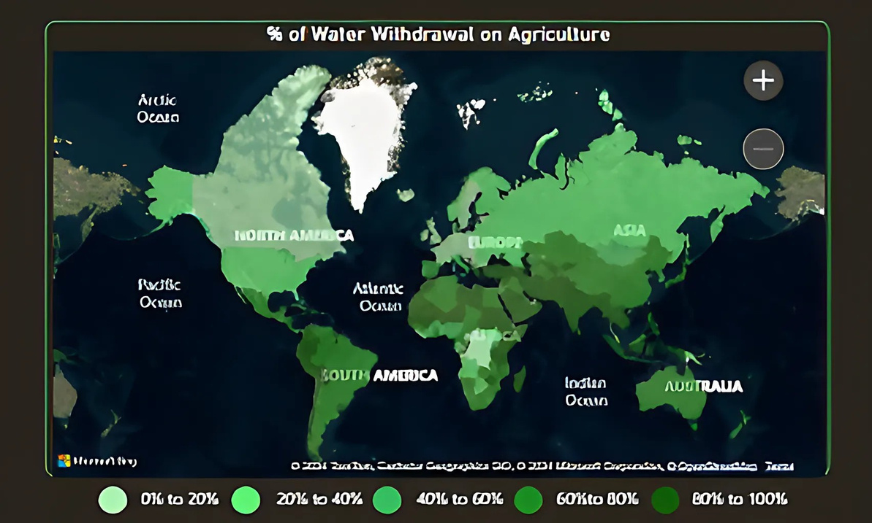
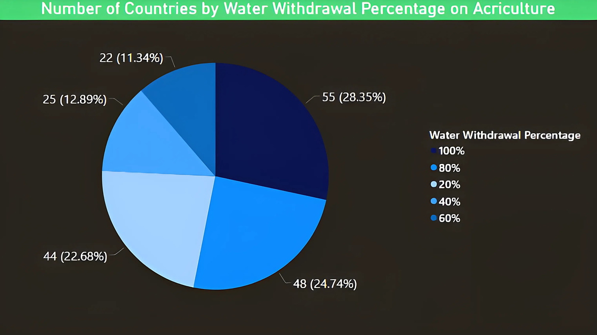
On average, farms around the world account for 70% of all water that is consumed annually. Of that 70% used by farmers, 40% is lost to the environment due to poor irrigation systems, evaporation and overall poor water management.
In 2020, Egypt's water usage for agriculture was 79.1% and the average water consumption in agriculture worldwide is 54%. If you look at the map and the pie chart, you will find that Southern European countries are the highest consumers of water, while the rest of the European continent consumes less water for agriculture. This indicates that temperature plays a significant role in increasing water consumption in agriculture.

Slide 10
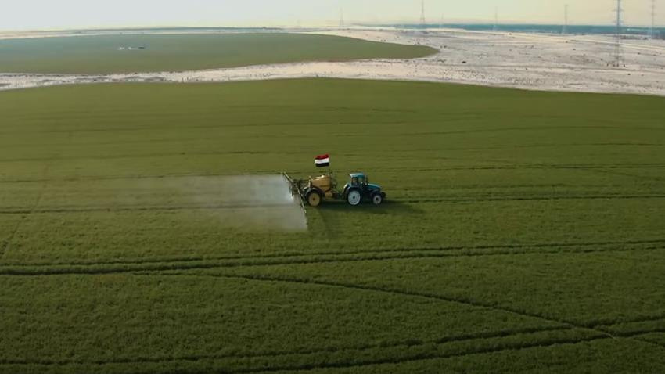
RESULTS
1- Egypt's presence in the top ranks of countries producing agricultural crops indicates that Egypt is advanced in agriculture and relies on modern farming techniques. It was ranked first in Farm Infrastructure in the Global Food Security Index 2022.
2- Considering the arable land area, Egypt's production is excellent, taking into consideration the different agricultural crops grown in Egypt and Nigeria, and that each crop has varying yields from the other.
3-The increase or decrease in production in 2022 compared to 2012, despite the increase in arable land, indicates that other factors negatively affected agricultural production. These factors include inflation, which significantly raised the cost of production inputs in 2022, and access to agricultural inputs, where Egypt is classified as "very weak." Additionally, Egypt is also classified as "very weak" in terms of water resources and political commitment to adaptation, which considers Early-Warning measures/climate-smart agriculture and national agricultural adaptation policy (Global Food Security Index 2022).
4- Egypt faces the challenges of climate change and water scarcity. The country is undertaking a canal lining project to reduce water evaporation and is implementing agricultural wastewater treatment plants to address water scarcity, treatment plants are now heavily relied upon.

